Slide 1


Preparation for On-Road Instruction
Video Clips

Slide 2
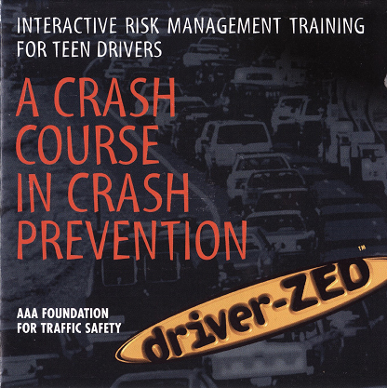
Acknowledgements
The video clips used in the Road Safety Education Program are taken from the DVD entitled
A Crash Course in Crash Prevention.
Use of these clips is made possible by CAA-Québec, courtesy of the AAA Foundation for Traffic Safety.

Slide 3
Purpose of the Document
This PowerPoint presentation contains 14 video clips, that is, one clip for each in-car session included in the Teaching Aid.
Watching these video clips will enable learner drivers to recognize both good and poor driving behaviour in various driving situations and apply the OEA (Observe – Evaluate – Act) strategy.

Slide 4
How to use this document
Watching the clips
In class: At the end of a theoretical module, the instructor takes a few minutes to show the video clip for the in-car session that follows the module.
Self-learning: The student watches the video clip on the Internet if it could not be shown in class.
Look in the rearview mirrors and watch the speedometer (in miles per hour) to gather information about the situation.

Slide 5
How to use this document (cont’d)
Applying the OEA strategy
  For each clip, ask yourself the following questions:
  What are the potential risks (Observe)?
  What events could potentially occur (Evaluate)?
  What actions should be taken (Act)?
Then, look at the table that follows the video clip to complete your answers.

Slide 6
In-Car Sessions 1 and 2

Slide 7
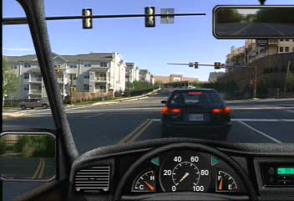
Clip 1
Click on the video to start the presentation.
7

Slide 8
Clip 1
Potential risks (Observe) | Potential events (Evaluate) | Actions to be taken (Act)

Slide 9
Clip 1
Potential risks (Observe) | Potential events (Evaluate) | Actions to be taken (Act)
Pedestrian Other vehicles travelling on the road | The pedestrian may cross the roadway A vehicle approaches from the opposite direction and intends to continue straight ahead The vehicle ahead stops suddenly Etc. | Slow down to let the pedestrian cross Maintain a safety margin with the vehicle ahead If possible, make eye contact with the pedestrian, as well as the driver of the vehicle travelling in the other lane Obey traffic rules, road signs and traffic signals

Slide 10
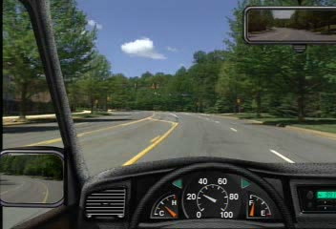
Clip 2
Click on the video to start the presentation.

Slide 11
Clip 2
Potential risks (Observe) | Potential events (Evaluate) | Actions to be taken (Act)

Slide 12
Clip 2
Potential risks (Observe) | Potential events (Evaluate) | Actions to be taken (Act)
Other road users (visible or not) | A collision with a vehicle approaching from the left Etc. | Obey traffic lights (stop at an amber light) Check mirrors and blind spots Wait for the green light before turning left Obey traffic rules, road signs and traffic signals

Slide 13
In-Car Sessions 3 and 4

Slide 14
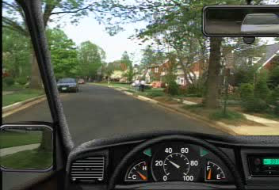
Clip 3
Click on the video to start the presentation.
14

Slide 15
Clip 3
Potential risks (Observe) | Potential events (Evaluate) | Actions to be taken (Act)

Slide 16
Clip 3
Potential risks (Observe) | Potential events (Evaluate) | Actions to be taken (Act)
Pedestrians, children, cyclists Other vehicles travelling on the road Parked vehicles Road layout (curve) | The door of a parked vehicle may open Pedestrians concealed by vehicles may suddenly appear on the road A vehicle may pull out of a private driveway An oncoming vehicle may suddenly appear (the layout of the road prevents the driver from anticipating events over a long distance) Etc. | Slow down and prepare to brake Remain attentive to the surroundings Remain attentive to other road users Obey traffic rules, road signs and traffic signals

Slide 17
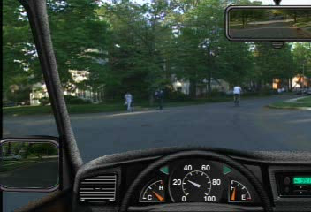
Clip 4
Click on the video to start the presentation.

Slide 18
Clip 4
Potential risks (Observe) | Potential events (Evaluate) | Actions to be taken (Act)

Slide 19
Clip 4
Potential risks (Observe) | Potential events (Evaluate) | Actions to be taken (Act)
Pedestrians, children, cyclists Other vehicles travelling on the road Parked vehicles Trees that obstruct the view Brake lights of a parked vehicle are on (vehicle is in operation) | The door of a parked vehicle may open Pedestrians concealed by vehicles or trees may appear suddenly on the road A vehicle may pull out of a private driveway A cyclist may suddenly change direction Etc. | Slow down and prepare to brake Be ready to stop Yield to the cyclist Remain attentive to the surroundings Remain attentive to other road users Be prepared for the driver to step out of the parked vehicle

Slide 20
In-Car Sessions 5 and 6

Slide 21
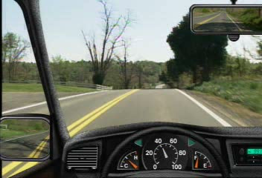
Clip 5
Click on the video to start the presentation.
21

Slide 22
Clip 5
Potential risks (Observe) | Potential events (Evaluate) | Actions to be taken (Act)

Slide 23
Clip 5
Potential risks (Observe) | Potential events (Evaluate) | Actions to be taken (Act)
Vehicles travelling in the opposite direction | A vehicle approaching from the opposite direction carries out a passing manoeuvre (not enough time to carry out the manoeuvre) | Slow down so the vehicle can safely carry out the passing manoeuvre Cooperate with other road users Obey traffic rules, road signs and traffic signals

Slide 24
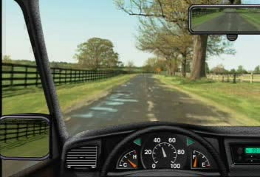
Clip 6
Click on the video to start the presentation.

Slide 25
Clip 6
Potential risks (Observe) | Potential events (Evaluate) | Actions to be taken (Act)

Slide 26
Clip 6
Potential risks (Observe) | Potential events (Evaluate) | Actions to be taken (Act)
Road layout (sharp curve) Wet road surface | The potential presence of other vehicles (collision) Loss of control of the vehicle | Slow down to adapt your speed to the curve and road conditions

Slide 27
In-Car Sessions 7 and 8

Slide 28
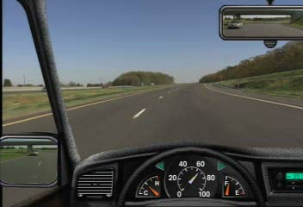
Clip 7
Click on the video to start the presentation.
28

Slide 29
Clip 7
Potential risks (Observe) | Potential events (Evaluate) | Actions to be taken (Act)

Slide 30
Clip 7
Potential risks (Observe) | Potential events (Evaluate) | Actions to be taken (Act)
Other vehicles travelling on the road Highway entrances | A collision with the vehicle located in the left-side blind spot The vehicle entering the highway does not yield | Check mirrors and blind spots Slow down or change lanes to make it easier for the vehicle to merge onto the highway The vehicle entering the highway must yield the right-of-way to vehicles already travelling on the highway

Slide 31
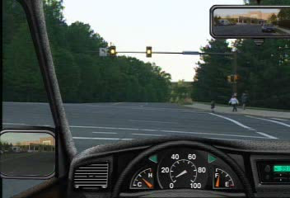
Clip 8
Click on the video to start the presentation.

Slide 32
Clip 8
Potential risks (Observe) | Potential events (Evaluate) | Actions to be taken (Act)

Slide 33
Clip 8
Potential risks (Observe) | Potential events (Evaluate) | Actions to be taken (Act)
Pedestrians, adults and children A pedestrian crosswalk | The pedestrian or the child may cross the road The child is not aware of the danger and may walk onto the roadway The presence of other road users | Make eye contact and give the pedestrian a signal to go ahead Maintain a safety margin with other road users Act in a manner that protects children Be patient Obey traffic rules, road signs and traffic signals

Slide 34
In-Car Sessions 9 and 10

Slide 35
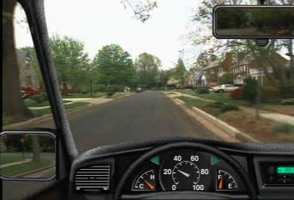
Clip 9
Click on the video to start the presentation.
35

Slide 36
Clip 9
Potential risks (Observe) | Potential events (Evaluate) | Actions to be taken (Act)

Slide 37
Clip 9
Potential risks (Observe) | Potential events (Evaluate) | Actions to be taken (Act)
Other vehicles parked on the roadside and in private driveways Other road users A child playing ball | The child may drop the ball and make a sudden move to retrieve it The door of a parked vehicle may open Parked vehicles may conceal the presence of other road users Vehicles parked in a private driveway may back up | Scan the surroundings Slow down and prepare to brake when you see the child Be ready to stop Maintain a side safety margin with parked vehicles

Slide 38
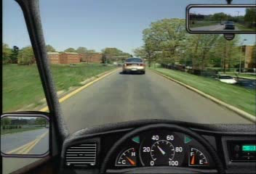
Clip 10
Click on the video to start the presentation.

Slide 39
Clip 10
Potential risks (Observe) | Potential events (Evaluate) | Actions to be taken (Act)

Slide 40
Clip 10
Potential risks (Observe) | Potential events (Evaluate) | Actions to be taken (Act)
Other vehicles travelling on the highway The vehicle ahead also intends to merge onto the highway A Yield sign Conversation with the passenger (distraction) | The vehicle ahead may be slow to merge onto the highway Vehicles travelling on the highway may be uncooperative and make it difficult to merge | Scan the surroundings Wait until the vehicle ahead has completely merged onto the highway Quickly check blind spots Merge onto the highway only when there is enough space and time to do so safely Maintain a safety margin with other road users

Slide 41
In-Car Sessions 11, 12 and 13

Slide 42
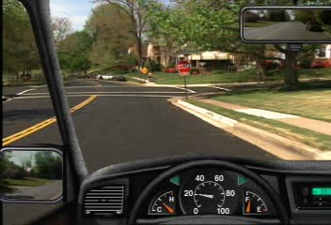
Clip 11
Click on the video to start the presentation.
42

Slide 43
Clip 11
Potential risks (Observe) | Potential events (Evaluate) | Actions to be taken (Act)

Slide 44
Clip11
Potential risks (Observe) | Potential events (Evaluate) | Actions to be taken (Act)
Pedestrians and cyclists Vehicles travelling in the opposite direction The park Parked vehicles | Pedestrians or cyclists may change direction The vehicle in the right lane fails to stop at a stop sign Children may decide to cross the road without checking for traffic The door of a parked vehicle may open Parked vehicles may conceal the presence of other road users | Scan the surroundings Slow down and prepare to brake when you see vulnerable road users (pedestrians and cyclists) Bring the vehicle to a complete stop at the stop sign, and yield the right-of-way to vulnerable road users

Slide 45
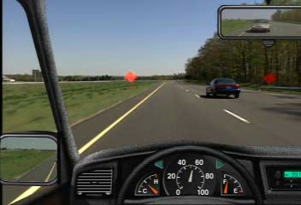
Clip 12
Click on the video to start the presentation.

Slide 46
Clip 12
Potential risks (Observe) | Potential events (Evaluate) | Actions to be taken (Act)

Slide 47
Clip 12
Potential risks (Observe) | Potential events (Evaluate) | Actions to be taken (Act)
Other vehicles travelling in both lanes Road work signs Music and conversation with the passenger (distractions) | A vehicle travelling in the right lane may intend to carry out a passing manoeuvre where the lane ends | Regularly check mirrors and blind spots Slow down and prepare to brake when approaching and travelling in work zones Slow down to give other vehicles enough space and time to carry out their manoeuvres Maintain a side safety margin with other road users

Slide 48
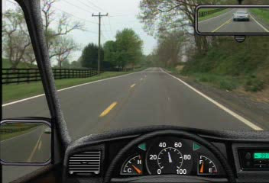
Clip 13
Click on the video to start the presentation.
48

Slide 49
Clip 13
Potential risks (Observe) | Potential events (Evaluate) | Actions to be taken (Act)

Slide 50
Clip 13
Potential risks (Observe) | Potential events (Evaluate) | Actions to be taken (Act)
Other drivers, who may make mistakes A vehicle travelling in the opposite direction A vehicle following behind Road geography (hill) | The vehicle following behind could carry out a passing manoeuvre even where there is a solid centre line The heavy vehicle may carry out an emergency manoeuvre, which could cause an accident | Scan the surroundings Slow down to let the driver safely carry out the passing manoeuvre Be prepared to stop quickly to prevent a potential collision between the vehicle carrying out the passing manoeuvre and the heavy vehicle

Slide 51
In-Car Session 14

Slide 52
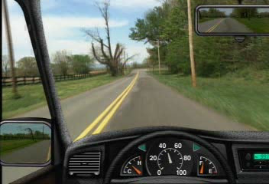
Clip 14
Click on the video to start the presentation.

Slide 53
Clip 14
Potential risks (Observe) | Potential events (Evaluate) | Actions to be taken (Act)

Slide 54
Clip 14
Potential risks (Observe) | Potential events (Evaluate) | Actions to be taken (Act)
A vehicle moving in the opposite direction goes out of control Road geography (curve) The view is obstructed by trees Speed | A collision between the vehicles Loss of control in the curve | Slow down and prepare to brake when you see the vehicle in trouble (and even stop your vehicle) Move onto the shoulder to increase the side margin with the vehicle in trouble Slow down and be prepared to brake as you approach the curve

